Slide 1
Mobile first design

Slide 2
What is mobile first design?
The mobile-first approach is exactly as it sounds: designing for the smallest screen and working your way up. It is one of the best strategies to create either a responsive or adaptive design.
The mobile-first approach is a tenet of progressive enhancement.
The opposite approach is graceful degradation.

Slide 3
Mobile-First = Content-First
If your site is good on a mobile device, it translates better to all devices.
Mobile has the most limitations, screen size and bandwidth to name a few, and so designing within these parameters force you to prioritize content ruthlessly.
The mobile-first approach organically leads to a design that’s more content-focused, and therefore user-focused.
One caveat, though, is that mobile users sometimes require different content than desktop users.

Slide 4
Steps to follow
1. Content Inventory — This is a spreadsheet or equivalent document containing all the elements you want to include.
2. Visual Hierarchy — Prioritize the elements in the content inventory and determine how to display the most important elements prominently.
3. Design with the smallest breakpoints and then scale up — Build the mobile wireframe first, then use that as the model for larger breakpoints. Expand the screen until there’s too much white space
4. Enlarge touch targets — Fingers are much wider than pixel-precise mouse cursors, and so need larger elements on which to tap. At the time of this writing, Apple recommends 44 pixels square for touch targets. Give hyperlinks plenty of space, and slightly enlarge buttons, and make sure that

Slide 5
Steps to follow
5. Don’t count on hovers — It almost goes without saying, but designers often rely on hover and mouseover effects in their interactive work. If you’re thinking mobile-friendly, don’t. There is no hover control for fingertips yet.
6. Think “app” — Mobile users are accustomed to motion and a modicum of control in their experience. Think about off-canvas navigation, expandible widgets, AJAX calls, or other elements on the screen with which users can interact without refreshing the page.
7. Avoid large graphics — Landscape photos and complex graphics don’t display well when your screen is only a few inches across. Cater to mobile users with images that are readable on handheld screens.
8. Test it in a real device — Nothing beats discovering for yourself how usable a website is (or isn’t). Step away from your desktop/laptop computer and load up your product on a real phone or tablet. Tap through pages. Is the site easy to navigate? Does it load in a timely fashion? Are the text and graphics easy to read?

Slide 6
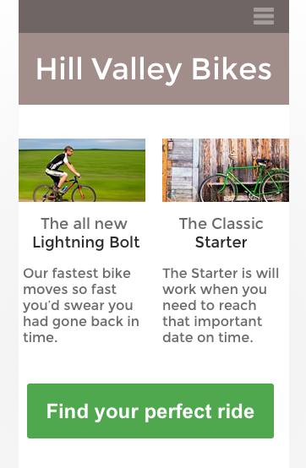
Design example
Smartphone view :
How much do users need?
Thinking mobile-first forces us to think about what’s really important

Slide 7
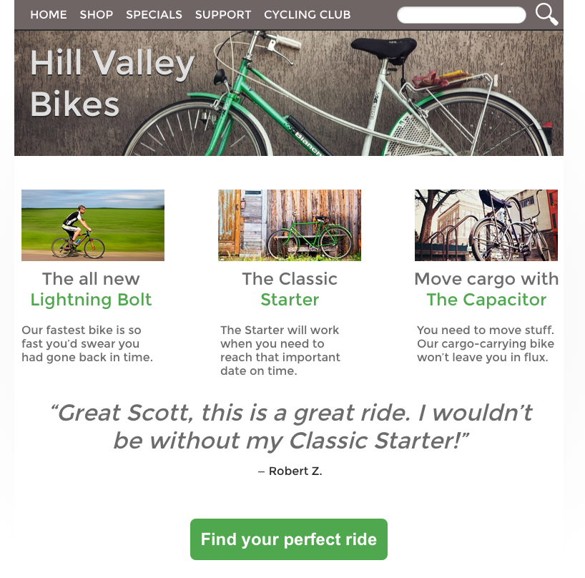
Design Example
Tablet view :
As we design for a tablet-sized view, we’re better able to add secondary information like additional products
We can also expand the navigation at the top of the page and add content that encourages sales without actually leading to them

Slide 8
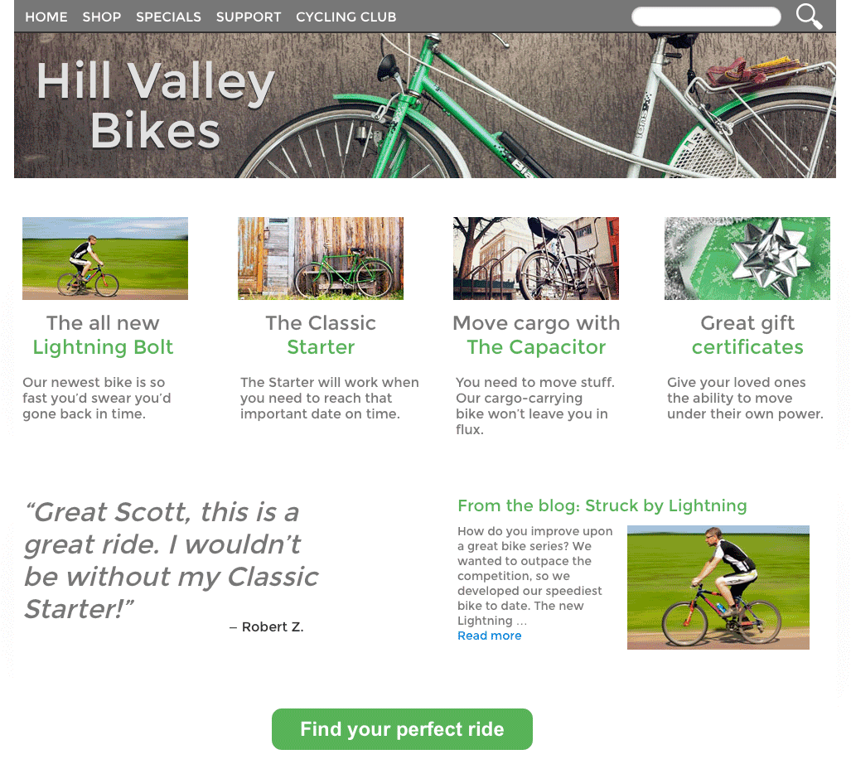
Design example
Desktop view :
Finally, the desktop view can support as much information as you decide is important. This is where the home page can accommodate all of the information you see fit, whether or not it fits.

